Slide 1
Case Study 0: Racial Disparities in Stop-Question-Frisk Events
By Austin Kao

Slide 2
Research Question
What racial disparities exist in SQF events where the police suspect a violent crime?

Slide 3
Variables
Response variable: SUSPECTED_VIOLENCE (1 if violent, 0 if not)
Predictor variables:
RACE
STOP_WAS_INITIATED
SUSPECT_HEIGHT
SUSPECT_REPORTED_AGE
SUSPECT_SEX
PRECINCT_PROP_BLACK
PRECINCT_PROP_HISP

Slide 4
Methodology
Combined data into one set
Filtered out incomplete/ impossible data
Added the proportions of Black and Hispanic residents living in precincts
Took a random sample of 3000 observations

Slide 5
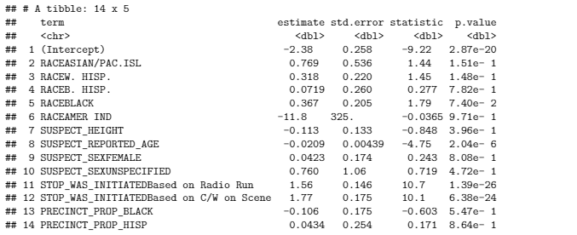
Results/Key Findings
Baseline: White male, mean height and age, stopped by officer who self initiated in a precinct with 0 Black and Hispanic residents
Race is the second-most significant factor
How police initiate the stop is most significant factor

Slide 6
Critiques/Improvements
Significant number of observations were filtered out because incomplete/impossible (3503 out of 36096 observations)
Officers who abuse SQF policy are less likely to report the SQF event
Populations within precincts change over time
Try to account for temporal relationships
Collect data on patrol routes

